Slide 1
Solar Simulator
ME 495 – Mechanical and Thermal Systems Lab
Group F
Kluch, Arthur
Le-Nguyen, Richard
Levin, Ryan
Liljestrom, Kenneth
Maher, Sean
Nazir, Modaser
Lentz, Levi

Slide 2
Introduction
Ricky

Slide 3
Theory of Cells
Sean

Slide 4
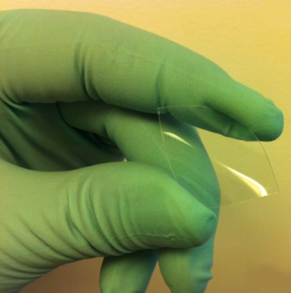
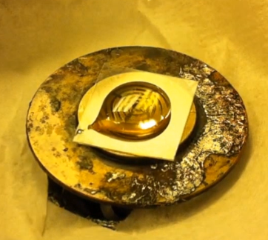
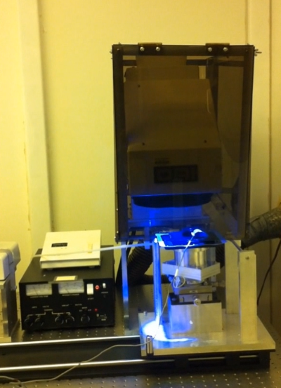
Manufacturing Theory – Substrate Creation
Polyethylene Terepthalate (PET) used as Substrate
Cleaned with Hydrofluoric Acid
Coated with Negative Photoresist SU-8 (10) using Spin Coating at 1000RPM
Exposed to UV, under filter, to create pillars.

Slide 5
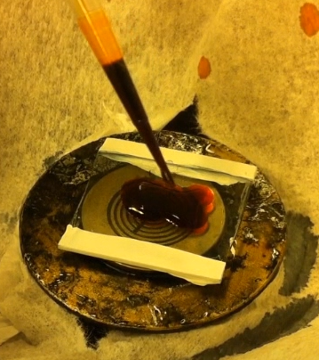
Manufacturing Theory – Material Deposition
Orgacon Deposited
P3HT:PCBM (biological) Deposited
Aluminum Evaporated on

Slide 6
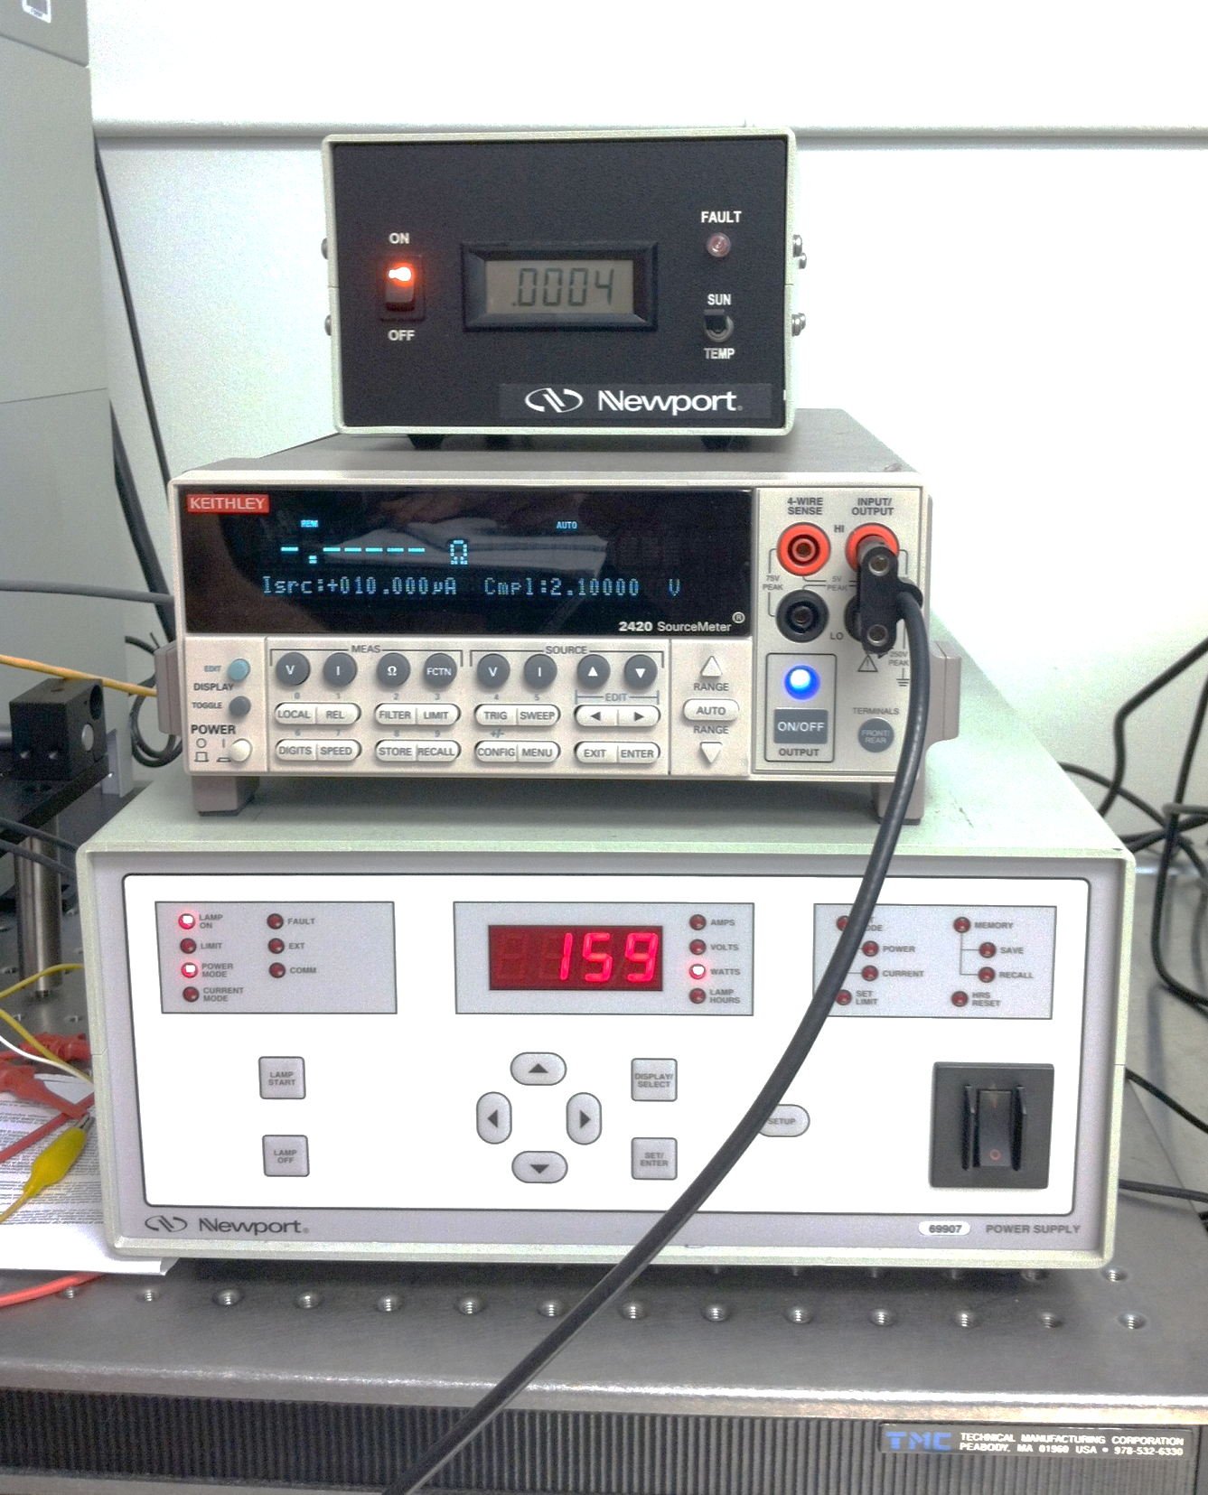
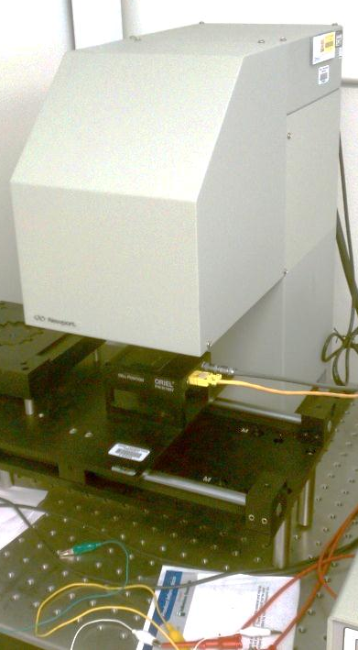
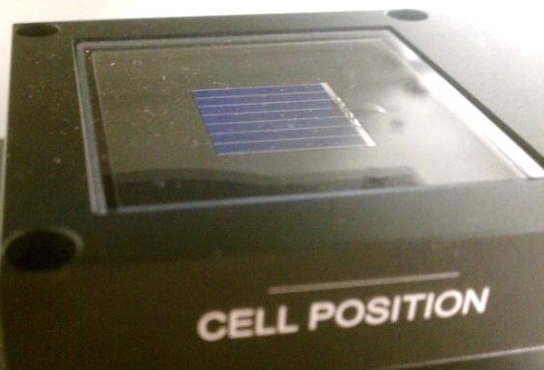
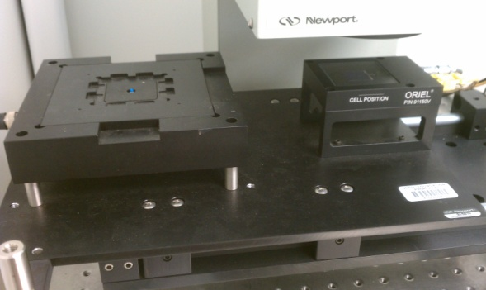
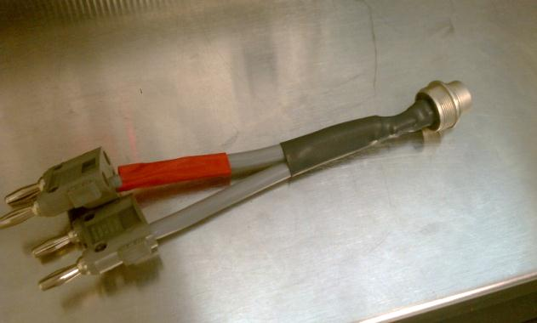
Testing Theory/Guide
Equipment used:
Newport Oriel I-V Test Station
Solar Simulator Lamp
Newport Reference Cell Meter
Source Meter
Solar Simulator Power Supply
Sliding Tray
Reference Cell
Banana Plug
Setup and Testing Guide:
Solar Cell Simulator Manual
Test a know solar cell
Test new organic solar cell

Slide 7
Instructional Video
Video Link

Slide 8
Results – From Program

Slide 9
Results – Efficiencies

Slide 10
Conclusion
Habib

