Slide 1
Combustion of Methane and Carbon
Project for ME653: Combustion
Dr. Bhattacharjee
Levi Lentz

Slide 2
Problem Statement
Equal parts of Methane and Carbon combust
  Plot the Adiabatic flame Temperature
    A. For the PG model
    B. For the IG model
Vary the ratio of Methane to Carbon
  Plot the Adiabatic flame temperature

Slide 3
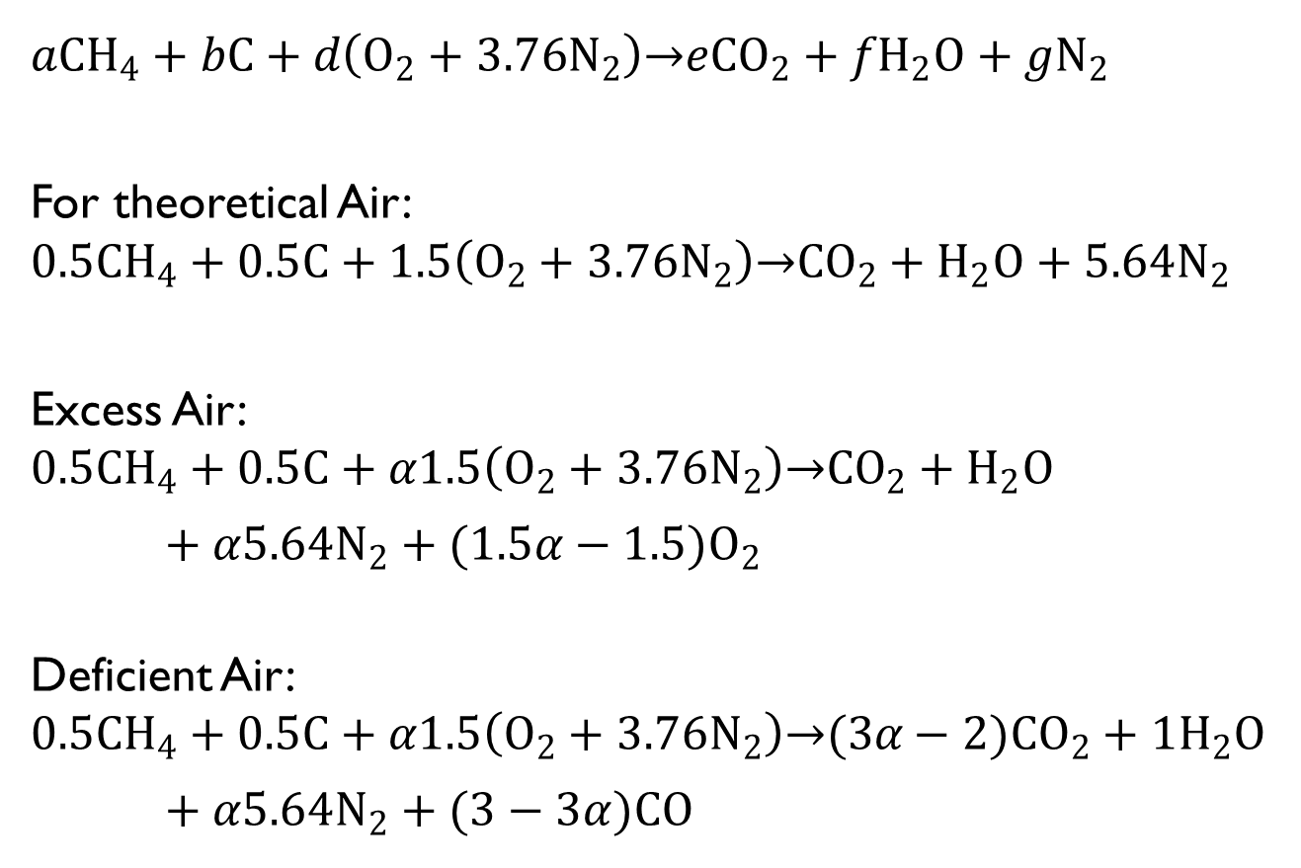
Chemical Balance
$$aCH_{4}+bC+d\left(O_{2}+3.76N_{2}\right)\overset{→}{}eCO_{2}+fH_{2}O+gN_{2}$$
For theoretical Air:
$$0.5CH_{4}+0.5C+1.5\left(O_{2}+3.76N_{2}\right)\overset{→}{}CO_{2}+H_{2}O+5.64N_{2}$$
Excess Air:
$$0.5CH_{4}+0.5C+α1.5\left(O_{2}+3.76N_{2}\right)\overset{→}{}CO_{2}+H_{2}O+α5.64N_{2}+(1.5α−1.5)O_{2}$$
Deficient Air:
$$0.5CH_{4}+0.5C+α1.5\left(O_{2}+3.76N_{2}\right)\overset{→}{}(3α−2)CO_{2}+1H_{2}O+α5.64N_{2}+(3−3α)CO$$

Slide 4
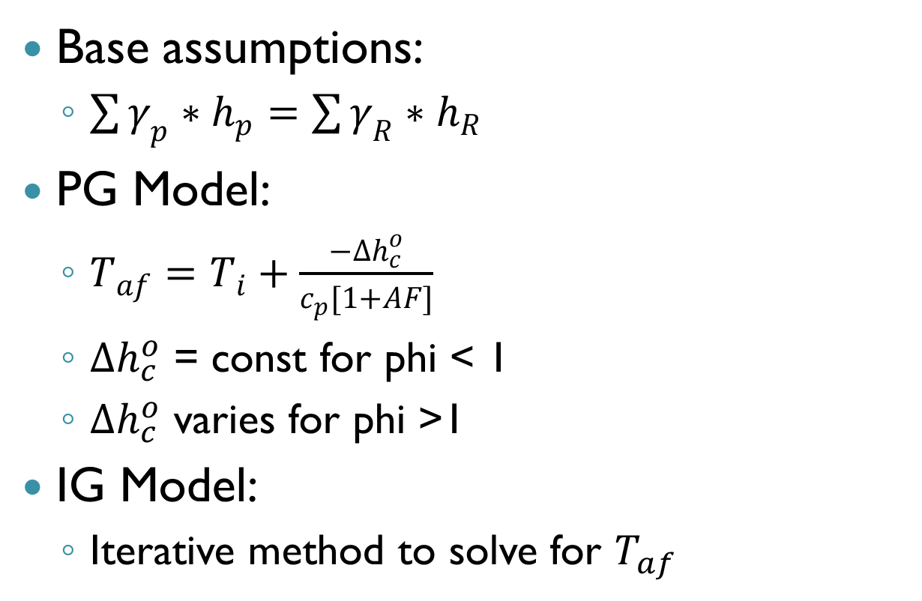
Mathematical Model
Base assumptions:
  $\sum{γ_{p}∗h_{p}}=\sum{γ_{R}∗h_{R}}$
PG Model:
  $T_{af}=T_{i}+\frac{−∆h_{c}^{o}}{c_{p}[1+AF]}$
  $∆h_{c}^{o}$ = const for phi < 1
  $∆h_{c}^{o}$ varies for phi >1
IG Model:
  Iterative method to solve for $T_{af}$

Slide 5
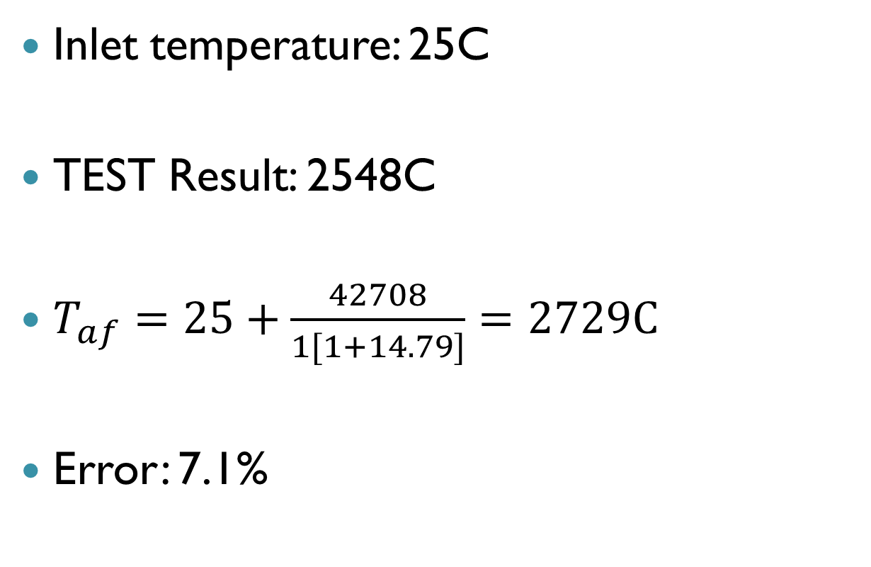
Error for Theoretical Air
Inlet temperature: 25C
TEST Result: 2548C
$T_{af}=25+\frac{42708}{1[1+14.79]}=2729C$
Error: 7.1%

Slide 9
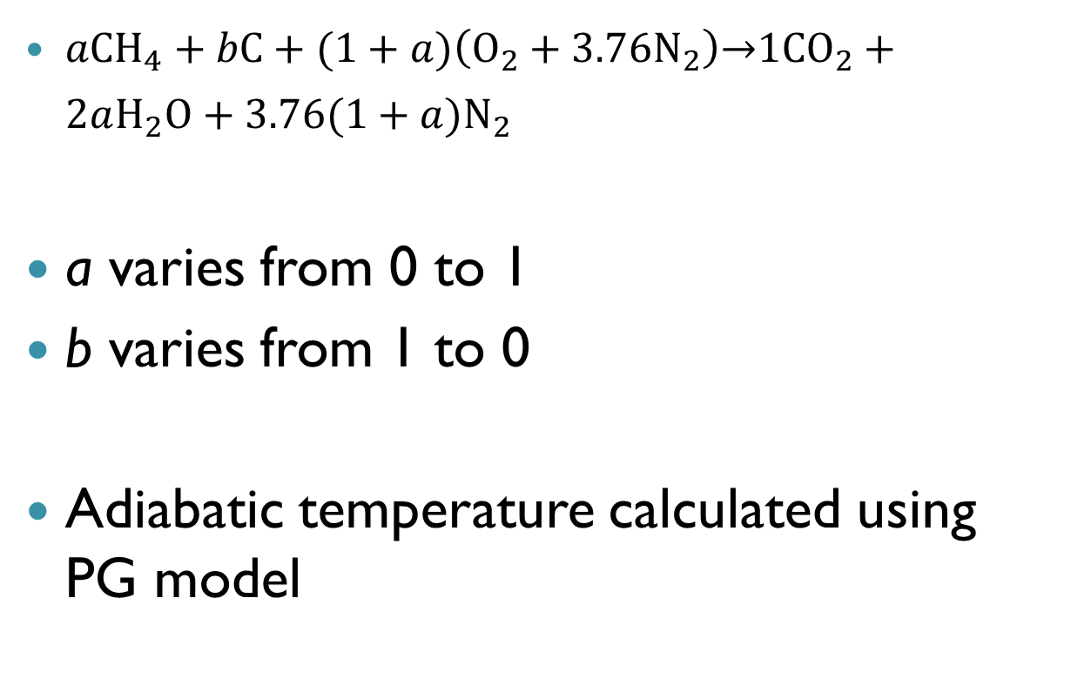
Variance of Methane: Model
$aCH_{4}+bC+(1+a)\left(O_{2}+3.76N_{2}\right)\overset{→}{}1CO_{2}+2aH_{2}O+3.76(1+a)N_{2}$
a varies from 0 to 1
b varies from 1 to 0
Adiabatic temperature calculated using PG model

Slide 11
Questions?

