Slide 1
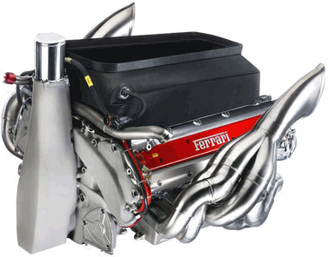
FORMULA 1 RACING: SILICON NITRIDE ENGINE
Levi Lentz
Greg Berkeley
Christian Igartua
Javies Banuelos
Arthur Kluch

Slide 2
Why a Formula 1 Racing Engine?
Can an internal combustion engine be more efficient by changing the materials used?
Can an internal combustion engine create more power with the same amount of fuel?

Slide 3





OUR COMPETITION
The spending per team is as follows:
McLaren Mercedes: $400M
Toyota: $393M
Honda : $382M
BMW Sauber: $378M
Ferrari: $329M
Renault: $300M
Red Bull Racing: $201M
Williams: $134M
Super Aguri: $95M
Midland F1: $76M
Scuderia Toro Rosso: $66M

Slide 4
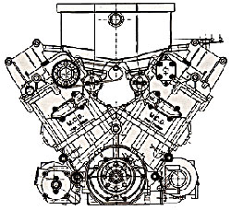
Design constraints and assumptions
Current rules limit us to use a naturally aspirated 2.4L 90° V8 engine
Our design is limited to the cylinder sleeve/liner and the piston
Analysis performed at 19,250 RPM

Slide 5
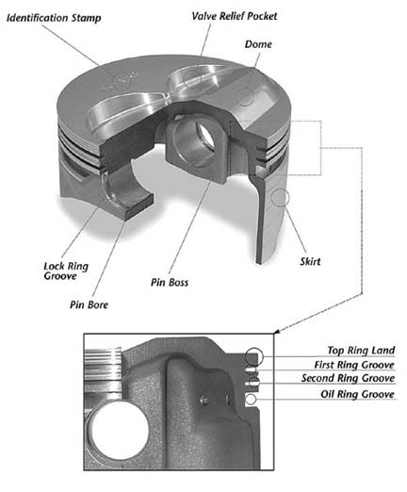
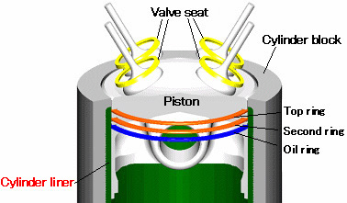

Slide 6
Why Silicon Nitride

Slide 7
Here’s Why
 | Si3N4 |  |  | Zinc Alloys |  | Mg Alloys |  | Aluminum
 | Sintered-Reaction Bonded | Sintered | Hot Pressed | Zamak 3 | Zamak 5 | AZ91A | AZ91D | 6061
Modulus of Elasticity | 300 GPa | 300 GPa | 300 GPa | 130 GPa | 130 GPa | 45 GPa | 45 GPa | 68.9 GPa
Shear Modulus | 148 MPa | No data found | No data found | 214 MPa | 262 MPa | 17 GPa | 17 GPa | 26 GPa
Fracture Toughness | 5.0-8.0 MPa-sqrt(m) | 7.5 MPa-sqrt(m) | 4.5 MPa-sqrt(m) | 12.3 MPa*sqrt(m) | 2.1x10^7 N*m^-(3/2) | no data found | no data found | 29 MPa-sqrt(m)
Thermal Expansion | 3.4 microm/K | 3.1 microm/K | 3.2 microm/K | 27 microm/K | 27 microm/K | 26 microm/m*K @ 20-100degC | Same as AZ91A | 25.2 microm/m-Deg C
Thermal Conductivity | 27 W/m-K | 22 W/m-K | 26 W/m-K | 113 W/m*K | 110 W/m*K | 72W/m*K @ 100-300degC | Same as AZ91A | 167 W/m-K
Thermal Shock Resistance | 700 deltaT Deg-C | 800 DeltaT Deg-C | 700 DeltaT Deg-C
Density | 3.31 g/cm3 | 3.24 g/cm3 | 3.2 g/cm3 | 6.6g/cm3 | 6.7g/cm3 | 1.81g/cm3 | 1.81g/cm3 | 2.7 g/cm3
Melting point | 1500+ Deg-C |  |  | 380-387 degC | 380-386 degC | 421 degC | 421 degC | 582-652 Deg-C
-Silicon Nitride [SN for short] has high strength, low thermal conductivity and expansion rates
-Other alloys have low melting points

Slide 8
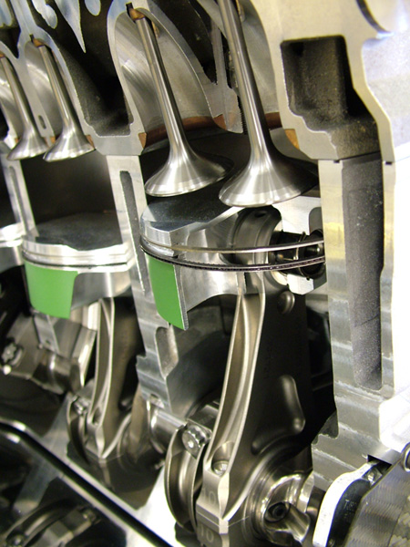
Material Analysis

Slide 9
Internal Pressure Variation

Slide 10
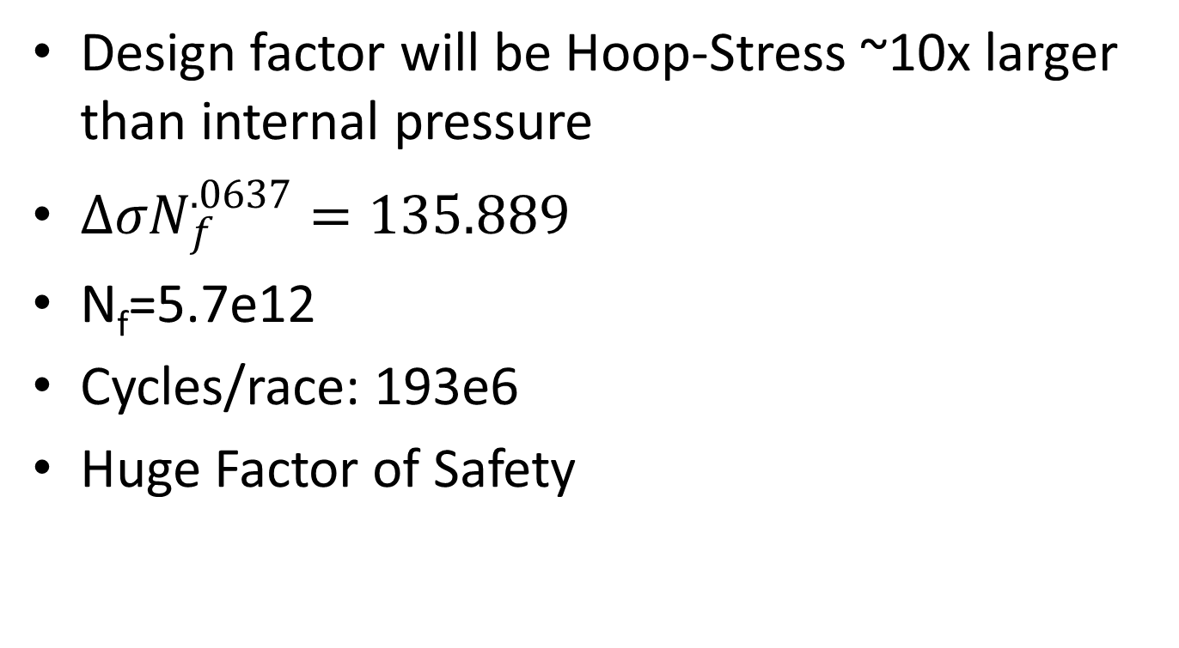
Cyclic Loading/Material Life
Design factor will be Hoop-Stress ~10x larger than internal pressure
$∆σN_{f}^{.0637}=135.889$
N_{f}=5.7e12
Cycles/race: 193e6
Huge Factor of Safety

Slide 11
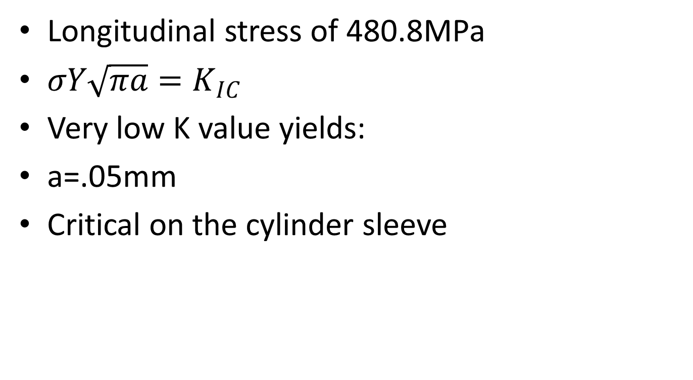
Thermal Stress
Longitudinal stress of 480.8MPa
$σY\sqrt{πa}=K_{IC}$
Very low K value yields:
a=.05mm
Critical on the cylinder sleeve

Slide 12
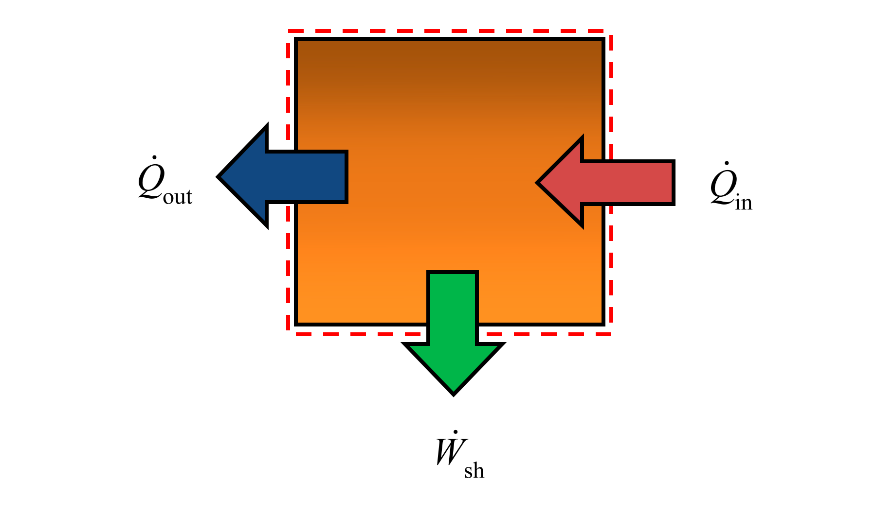
Thermal Analysis
Closed Steady State

Slide 13
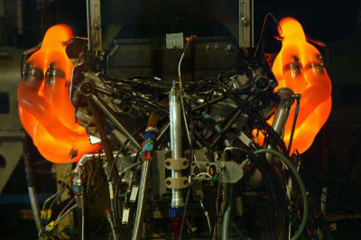
Maximum Power
33% Efficiency
Heat Transfer

Slide 14
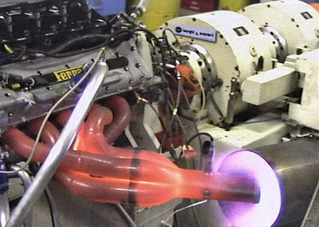
39.4%

Slide 15
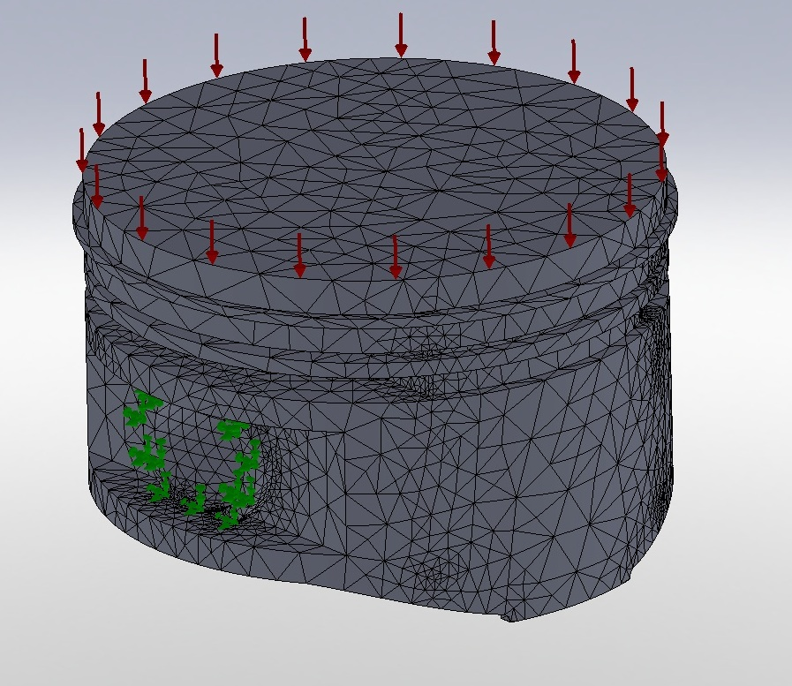
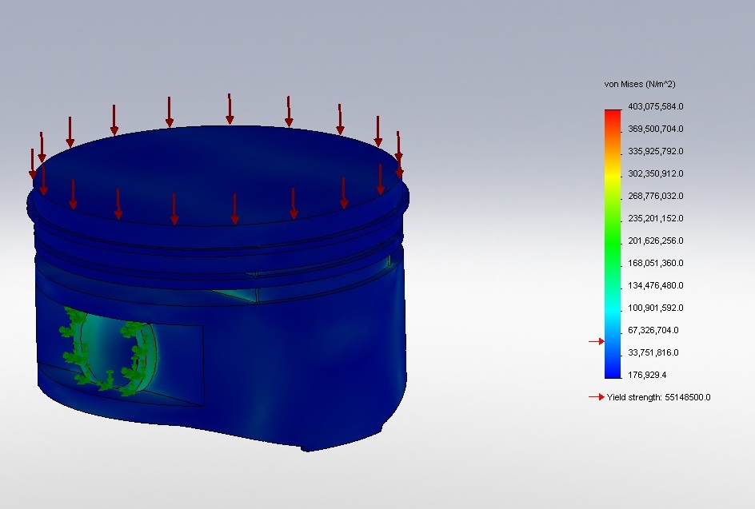
Aluminum Piston FEA Results
Stress Analysis

Slide 16
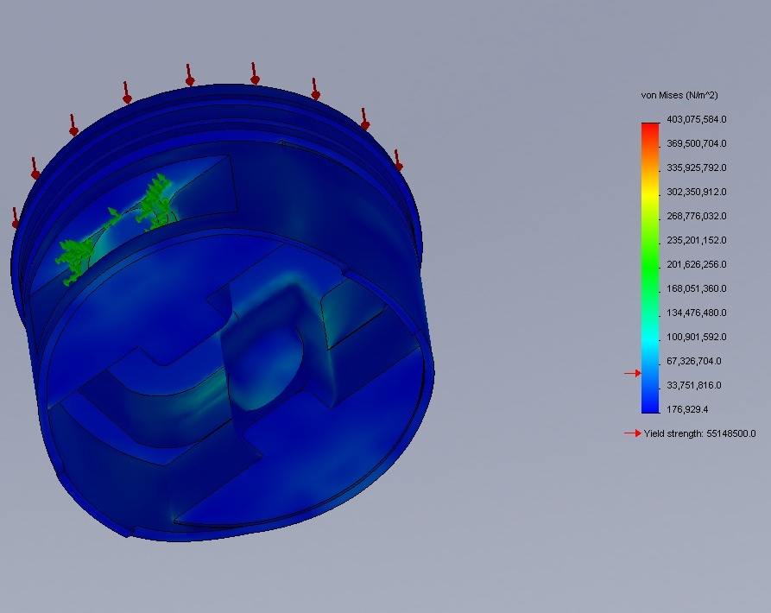
Bottom View of Piston

Slide 17
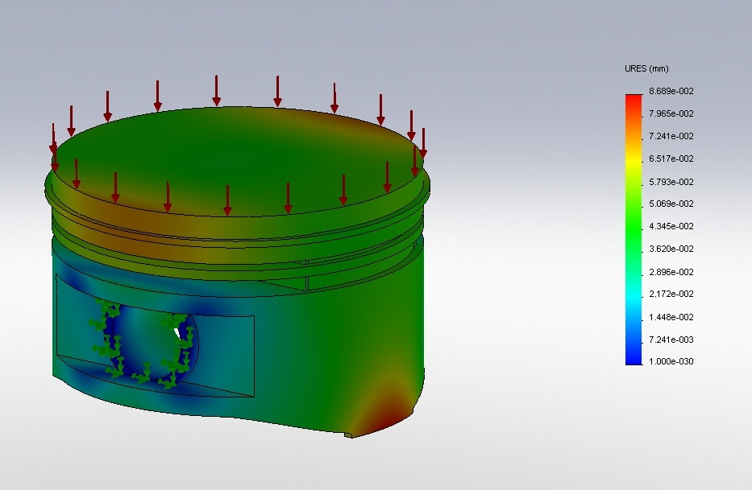
Displacement Results

Slide 18
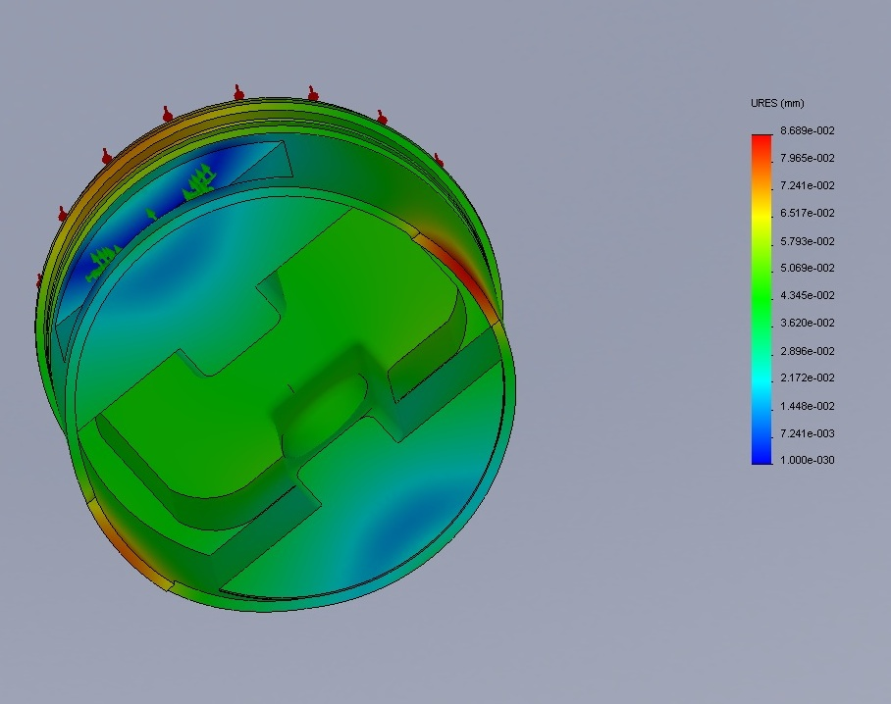
Bottom View

Slide 19
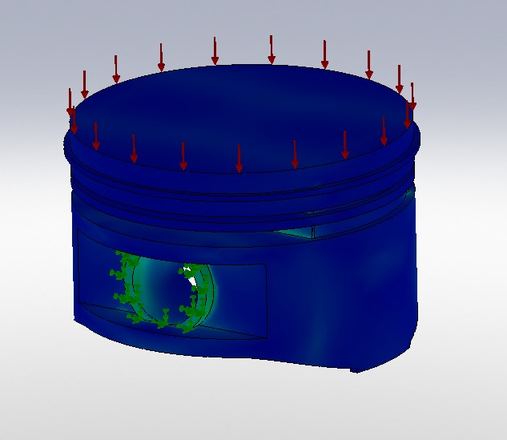
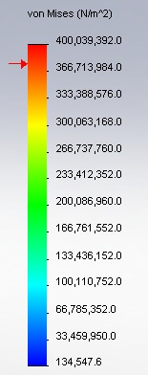
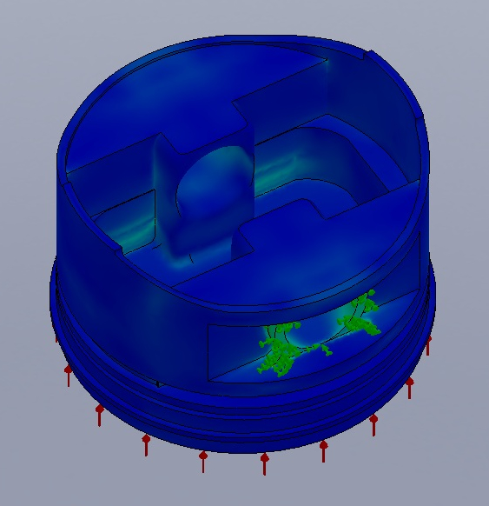
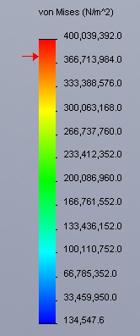
Silicon Nitride FEA Results
Stress Analysis

Slide 20
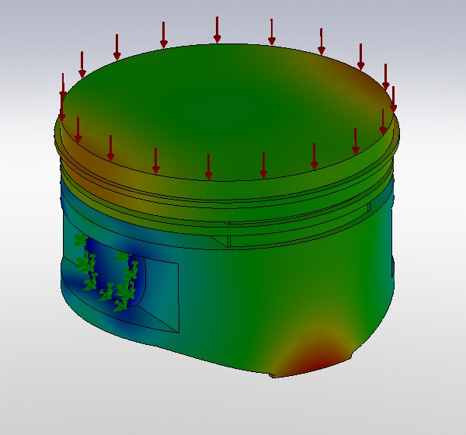
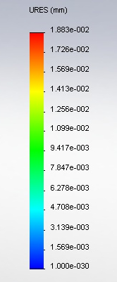
Displacement Results

Slide 21
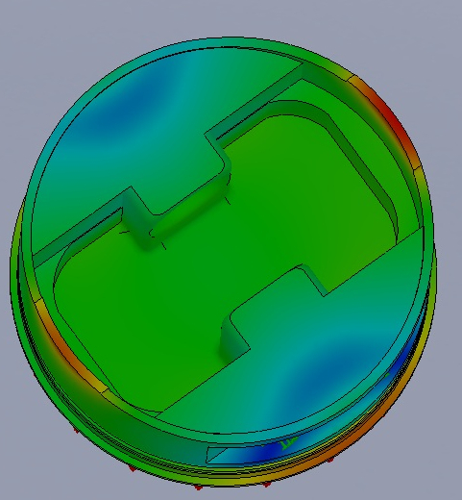
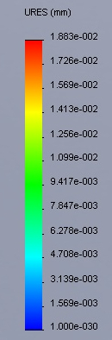
Bottom View

Slide 22
Manufacturing Processes
There are a few methods in use today to manufacture SN
Hot Pressed SN: Heated to 1800 Deg-C and pushed through a die at 40 MPa of pressure. Only simple shapes possible and expensive.
Reaction Bonded SN: Cheaper and capable of complex shapes, but inferior material.
Sintered SN: Best material properties, but expensive and high shrink rate (17-21%). Extra machining needed.
Sintered and Reaction Bonded SN: A mating of RBSN and SSN. High quality material, cheaper and capable of complex shapes with little extra machining. Fabrication method of choice.

Slide 23
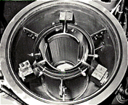
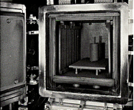

Slide 24
What is Sintered Reaction Bonded Silicon Nitride?
(SRBSN for short!)
Silicon powder packed into a mold, seeded with Beta-SN particles and mixed with sintering additives (Y2O3–MgSiN2 and Li2O).
Powder then undergoes a nitriding process creating SN
Sintering is then applied to further increase material strength and density, but a little material shrinkage occurs (10-12%).

Slide 25
Benefits of Beta-SN seeding
-Increased fracture strength
-Increased fracture toughness

Slide 26
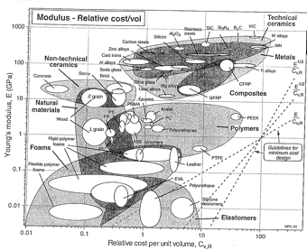

Slide 27
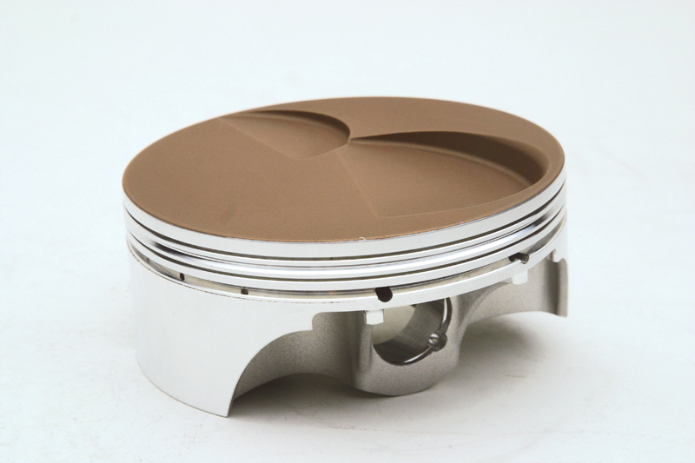
What's the cost?
High materials cost and specialized fabrication methods are expensive.
Fabrication time measures in hours because of special material preparations.
Estimated cost per SN part will be $450 per kg.
Pistons will cost about $650 each.

Slide 28
Future Design Considerations
Silicon Nitride Works
FIA Rules
Aluminum-type material
Easier to manufacture
Similar thermal-properties

