Slide 1
Material Analysis

Slide 2
Internal Pressure Variation

Slide 3
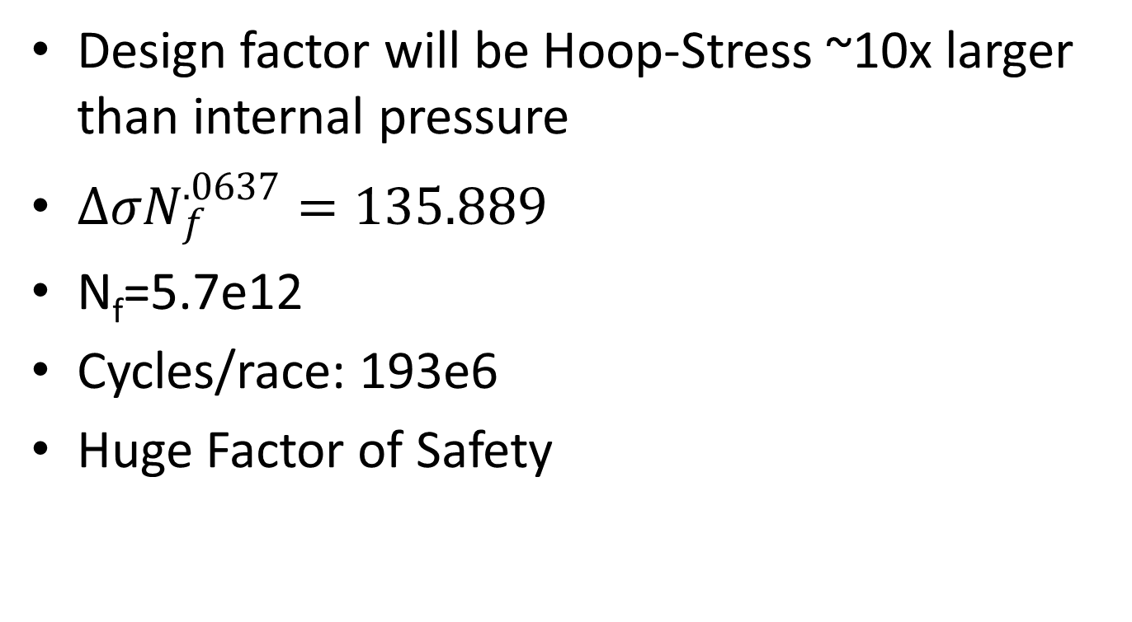
Cyclic Loading/Material Life
Design factor will be Hoop-Stress ~10x larger than internal pressure
$∆σN_{f}^{.0637}=135.889$
N_{f}=5.7e12
Cycles/race: 193e6
Huge Factor of Safety

Slide 4
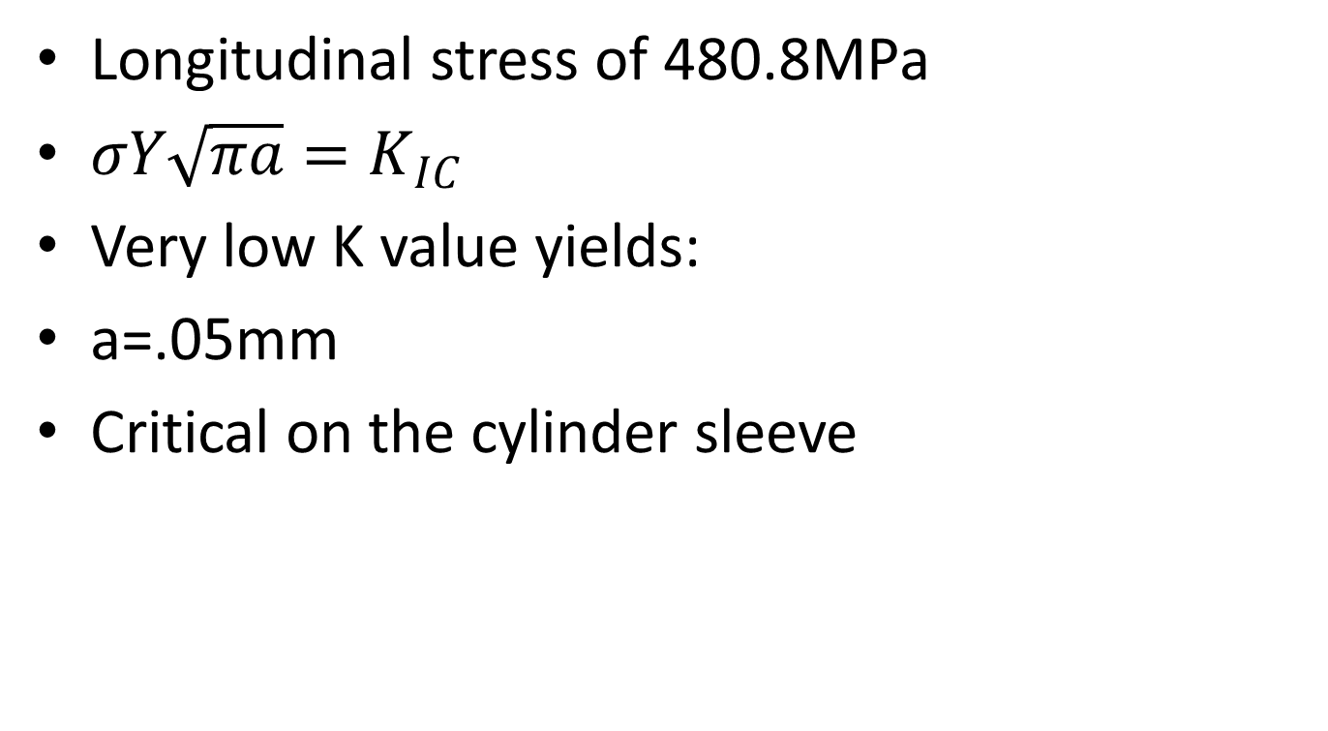
Thermal Stress
Longitudinal stress of 480.8MPa
$σY\sqrt{πa}=K_{IC}$
Very low K value yields:
a=.05mm
Critical on the cylinder sleeve

