Slide 1
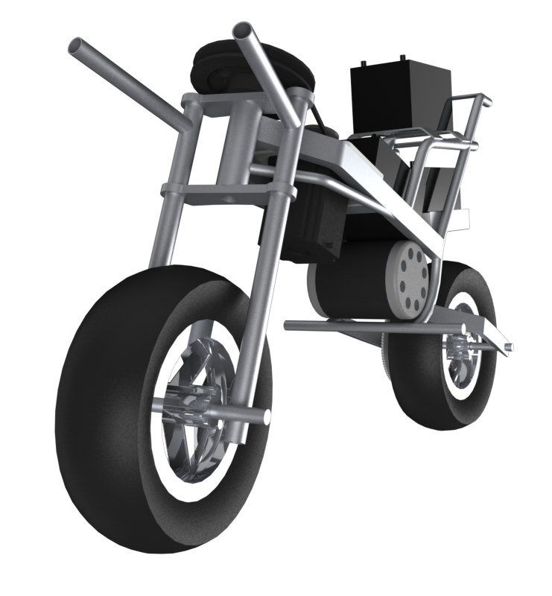
AUTOMOTO
Gregory Berkeley & Levi Lentz

Slide 2
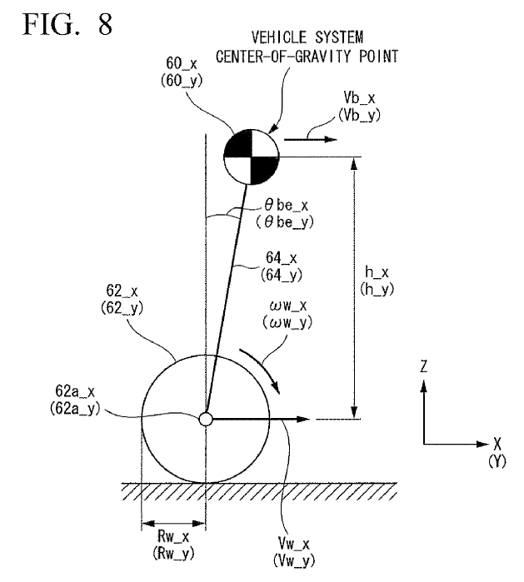

Slide 3
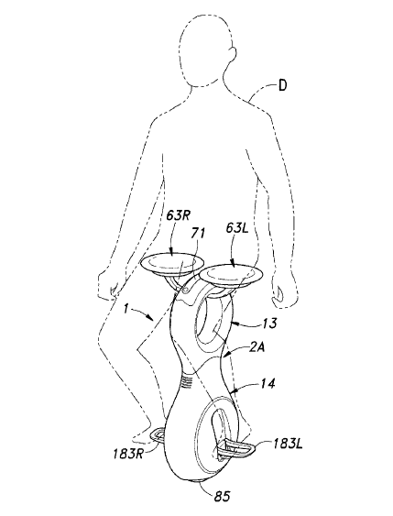

Slide 4
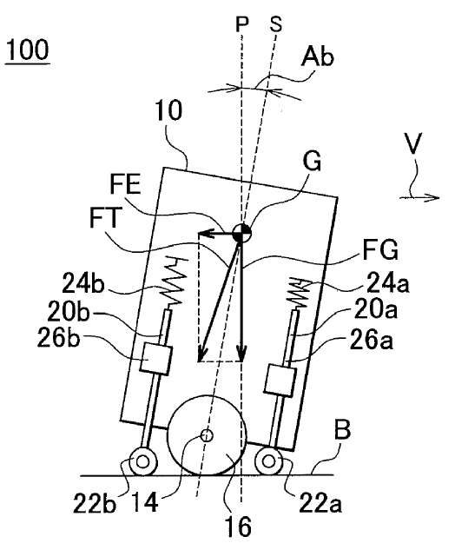

Slide 5
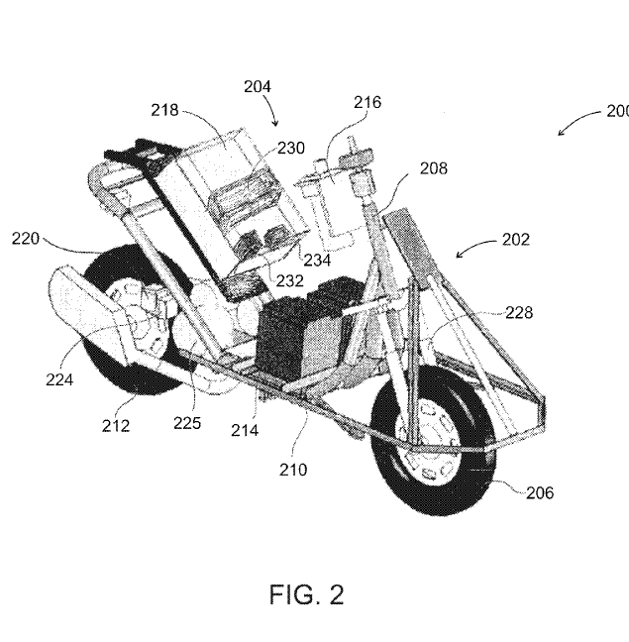

Slide 6
Design 1
Design 1

Slide 7
Design 2
Design 2

Slide 8
Design 3
Design 3

Slide 9
Design 4
Design 4

Slide 10
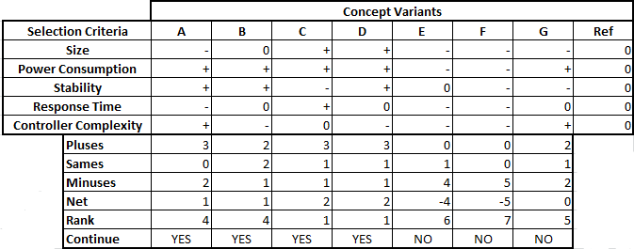
Selection Process

Slide 13
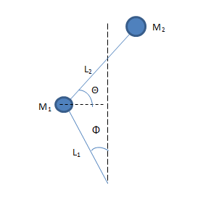
Theory

Slide 14
Future
Meet with a control system engineer
Dr. Matthew Graham & Professor George Mansfield
Determine size and speed of motor required
Refine design
Remove stress concentrations
Determine torque required by motor
Continue to add to and refine design

