Slide 1
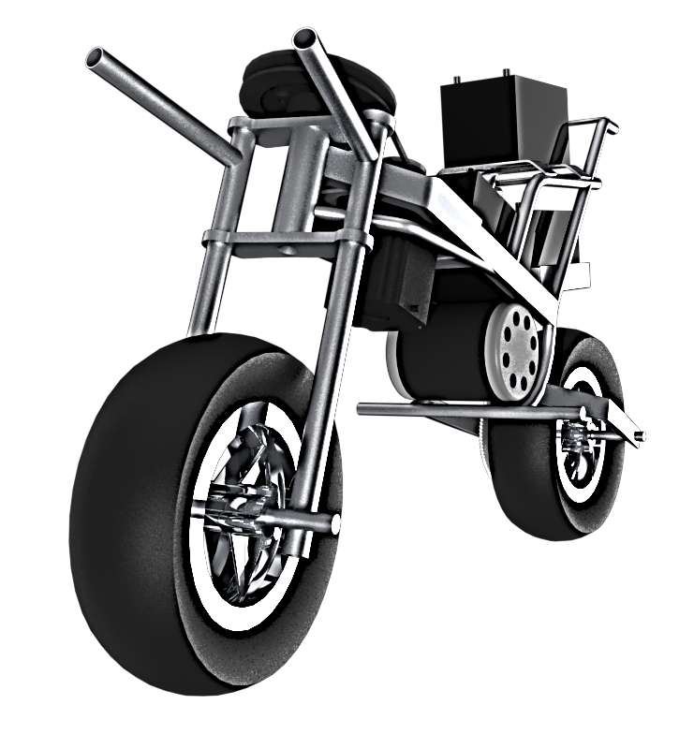
AutoMoto motorcycle control and stabilization
Engineered by
Gregory Berkeley
Levi Lentz
Notes:
Greg

Slide 2
Mathematical model

Slide 3
Mathematical model

Slide 4
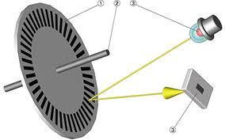
Drive encoder

Slide 5
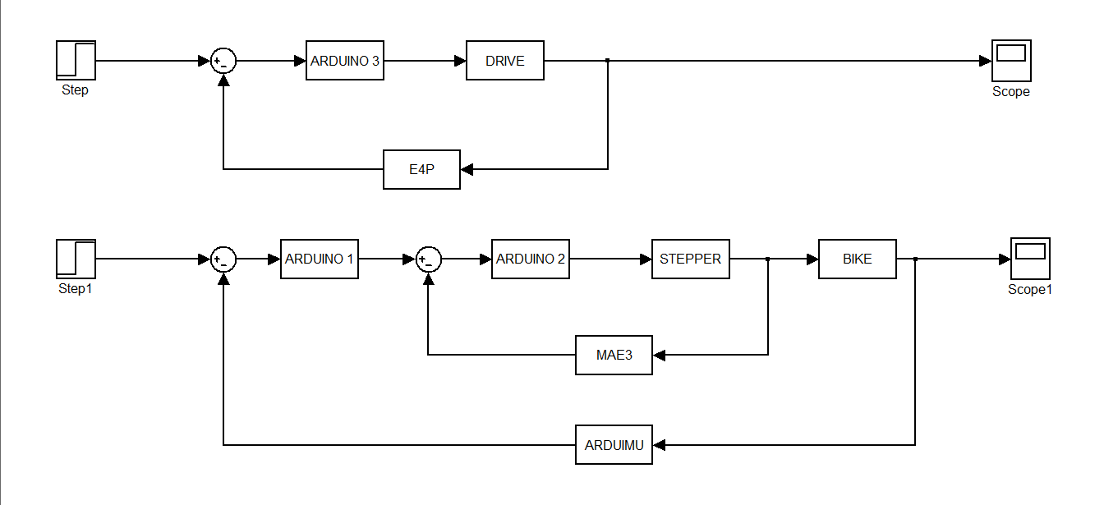
Control system
R_{v}(s)
R_{θ}(s)
θ(s)

Slide 6
Stability Wheels
Redesigned actuation lengths to fit actuators

Slide 7
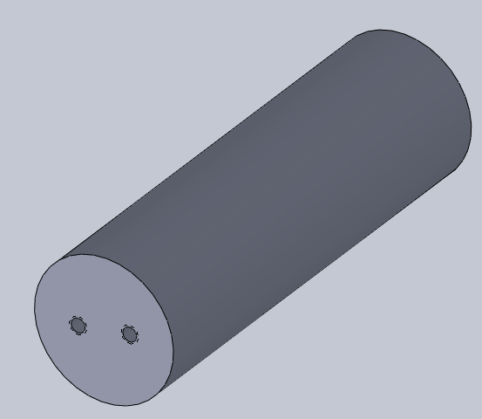
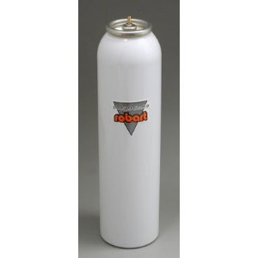
Designed own Pressure Vessel
Will incorporate regulator to 30PSI
Pumped via bike pump to 150PSI

