Slide 1
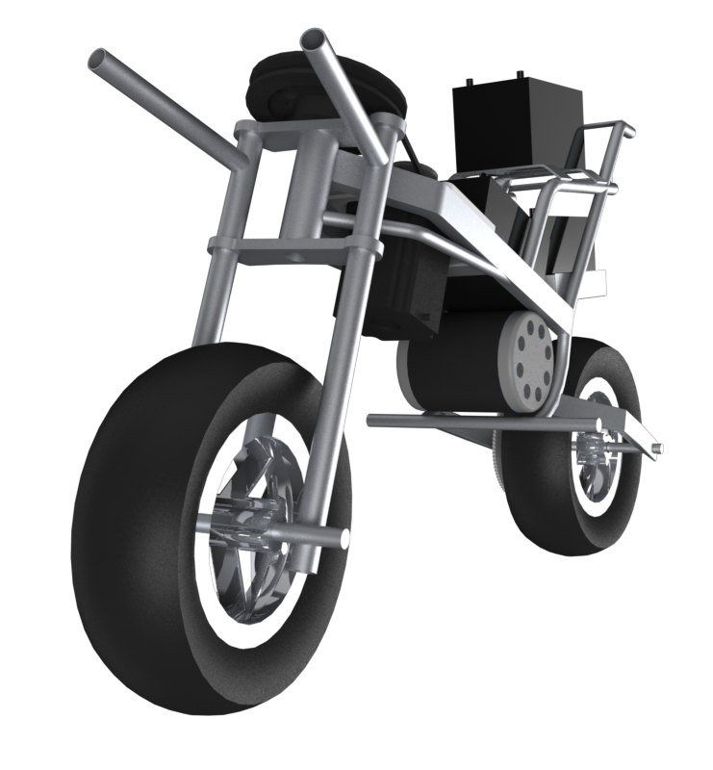
AUTOMOTO
Gregory Berkeley & Levi Lentz

Slide 2
Patents

Slide 3
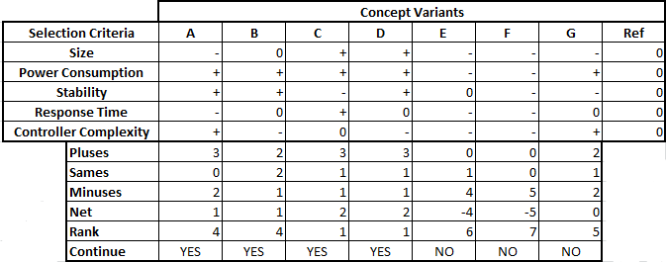
Selection Process

Slide 4
Design 1
Design 1

Slide 5
Design 2
Design 2

Slide 6
Design 3
Design 3

Slide 7
Design 4
Design 4

Slide 10
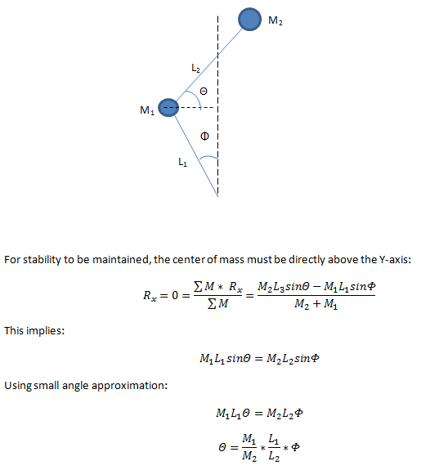
Theory

Slide 11
Block Diagram Representation
D(s)
Controller
Plant
R(s)
Θ(s)
Sensor

Slide 12
Future
Meet with a control system engineer
Determine size and speed of motor required
Refine design
Remove stress concentrations
Determine torque required by motor
Continue to add to and refine design

