Slide 1
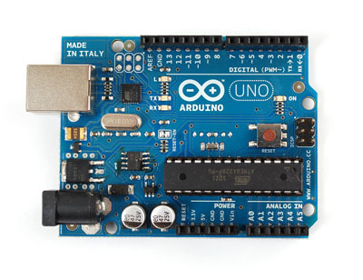
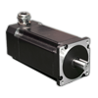
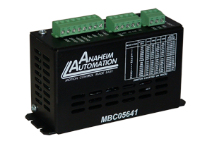
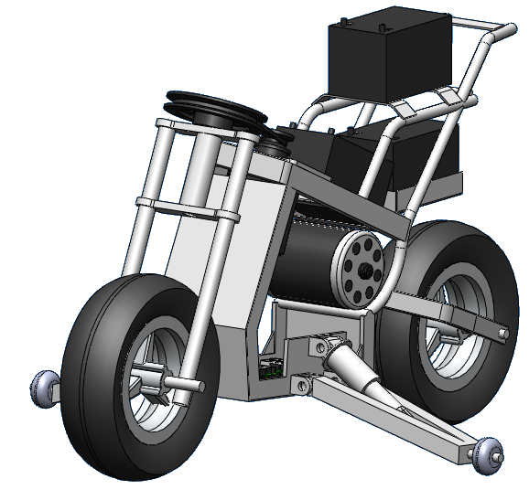
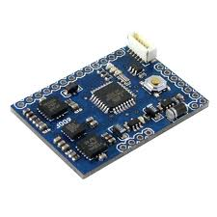
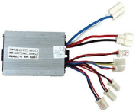
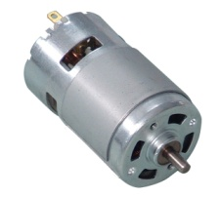
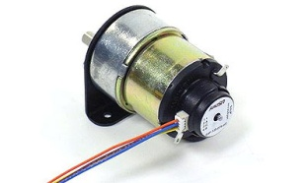
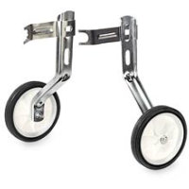
Feedback Encoder
AA 34Y
Steering Microcontroller
Arduino Uno
Step Motor Driver
AA MBC05641
1700 oz-in Step Motor
AA 34Y
Motorcycle Dynamics
Inclination Sensor
ArduIMU V2
Drive Microcontroller
Arduino Uno
Speed Controller
SPD-36500B
700W DC Motor
JX My1070
Feedback Tachometer
JX My1070
Ascend/Descend
Stabilizing Wheels
Stabilizing Wheels
Manufactured

Slide 2
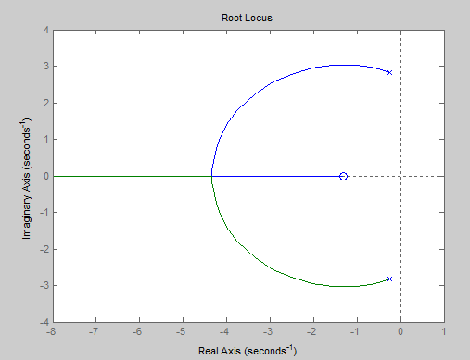

Slide 3
