Slide 1
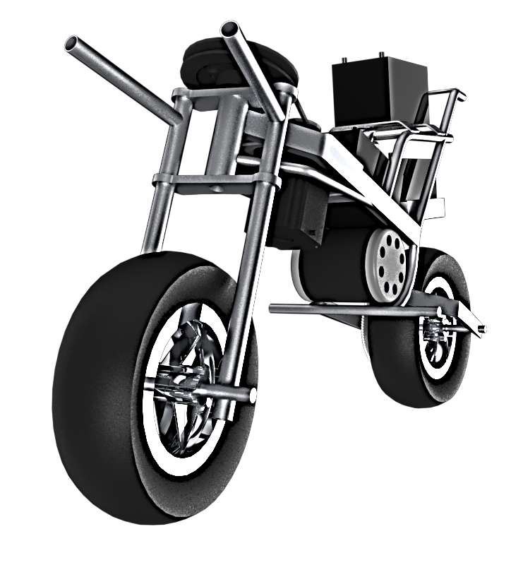
AutoMoto motorcycle control and stabilization
Gregory Berkeley
Levi Lentz

Slide 2
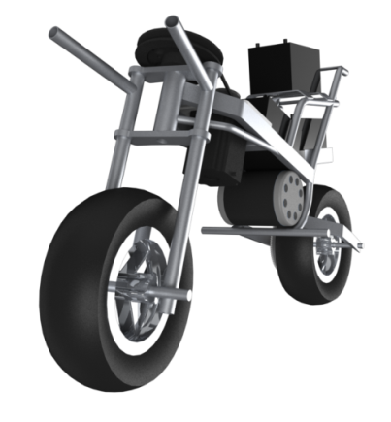
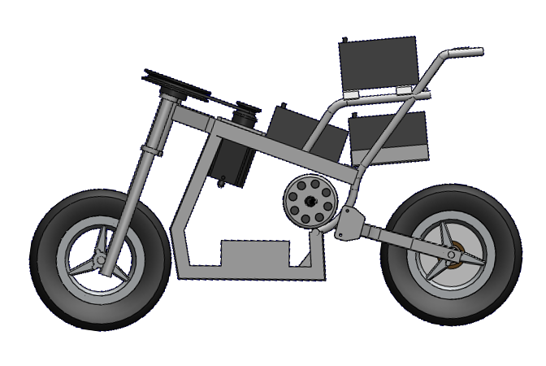
Previous prototype

Slide 3
outline
Background
Motivation and Objectives
Theory for Stabilization
UC Berkeley
Project Scope
Prototype Design
Control System
Theoretical Approach
Mathematical Model
Innovative Design
Plans for Completion
Manufacturing
Testing
Conclusion

Slide 4
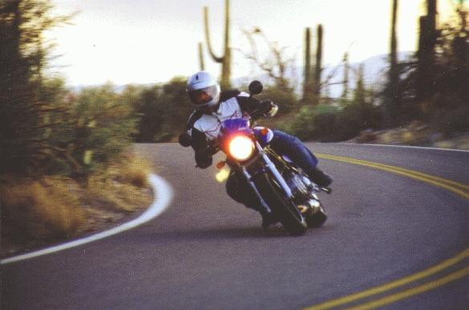
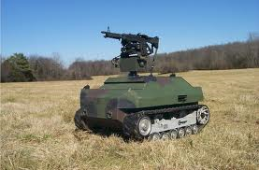
Motivation & objectives
Motivation
Safety
Military
Objectives
Study the behavior of motorcycle dynamics and achieve a method for stability of unmanned vehicles.
Present a sophisticated approach of feedback control theory to further develop an understanding of an autonomous motorcycle.

Slide 5
Theory for stabilization
Q: When you are riding a bicycle, how do you keep the bike from falling over?
A: By turning the front wheel

Slide 6
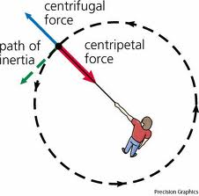
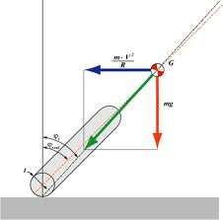
Theory for stabilization
Turning the front wheel generates a phenomena that allows a bicycle or motorcycle to achieve a stable vertical position.
Centrifugal Force

Slide 7
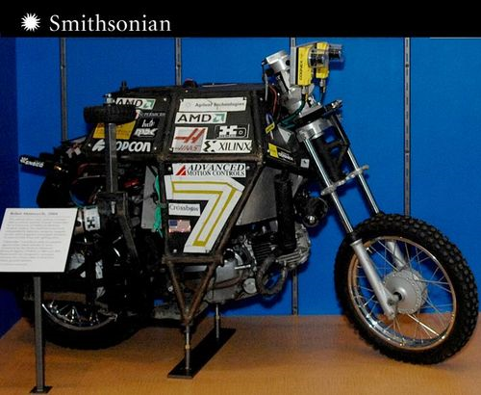
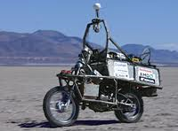
Uc Berkeley
In 2005, engineering students at UC Berkeley successfully built an autonomous motorcycle known as Ghost Rider.
Incorporates:
Inertial Measurement Sensor
Steering Actuator
Drive Tachometer
GPS
Obstacle Avoidance System

Slide 8
Prototype design
Sensors
Inertial Measurement Unit
Stepper Feedback Encoder
Drive Tachometer
Controllers
Speed Control
Stepper Motor Driver
Microprocessors
Arduino Uno
Steering Microcontroller
Drive Microcontroller
Actuators
700W DC Drive Motor
1200 oz-in Stepper Motor

Slide 9
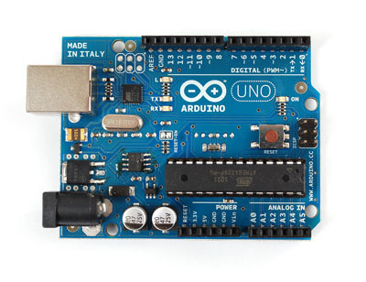
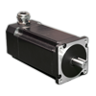
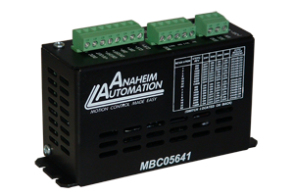
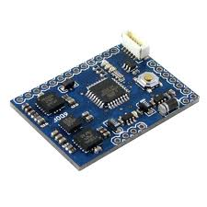
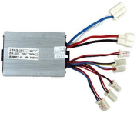
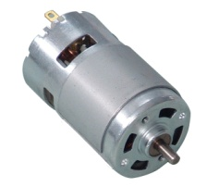
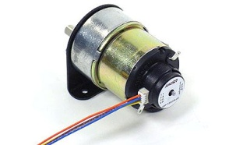
Control system
Motorcycle Dynamics

Slide 10
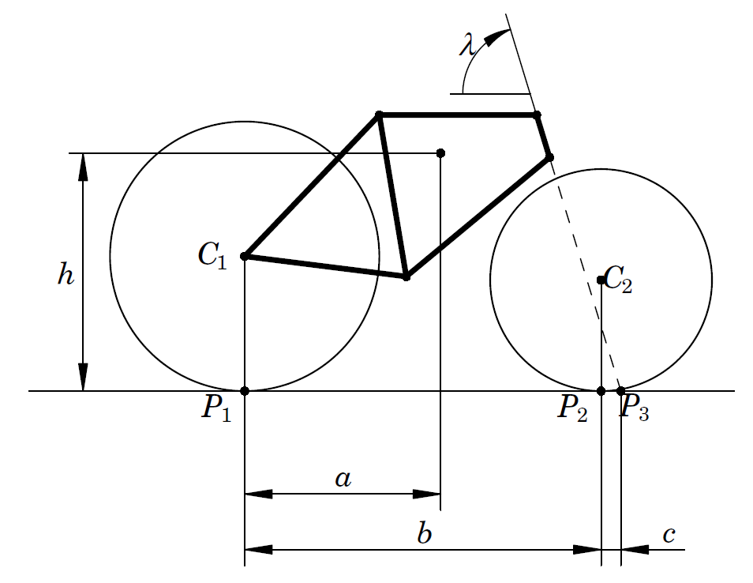
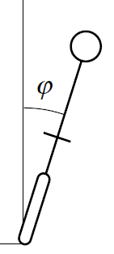
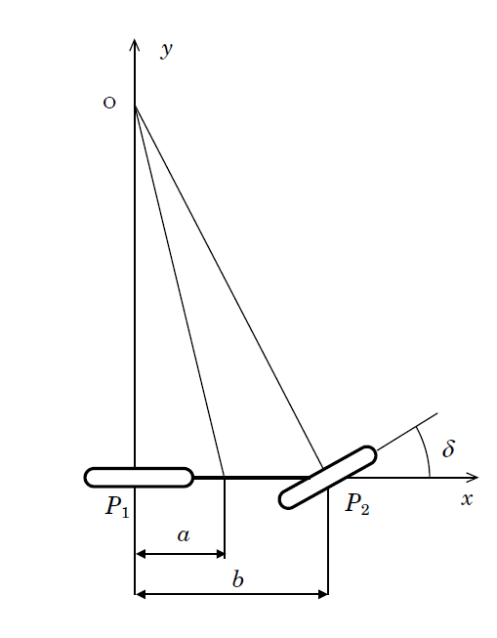
Mathematical model
Side View
Rear View
Top View

Slide 11
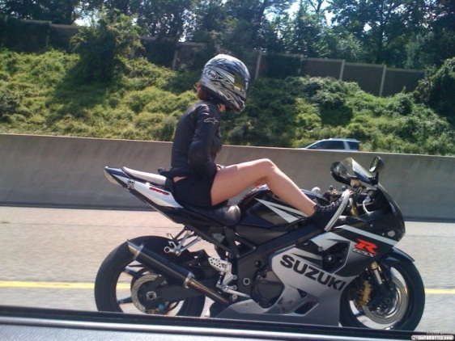
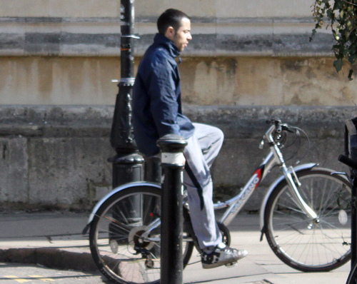
Mathematical model
A very important aspect of the mathematics was the ability to determine the “self stabilizing” or critical velocity.
You can think of this as the velocity that you can ride a bike with no hands!

Slide 12
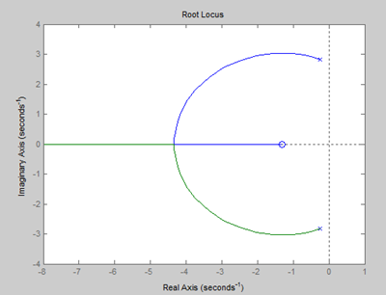
Mathematical Model
Transfer function and Root Locus for a velocity of 5 m/s
The Root Locus lies
entirely in the Left Hand
Plane
What does this imply for
our design?

Slide 13
Innovative design
If the bike can get up to its critical velocity in a stable state, the bike will maintain stability.
This implies that our motorcycle will have two control systems:
Primary Control will come from pure momentum.
Secondary Control will come from steering manipulation.
(Recall the two separate control systems from the diagram)
Q: How do we get the motorcycle to be stable at the critical velocity?
A: Design Actuated Stability Wheels

Slide 14
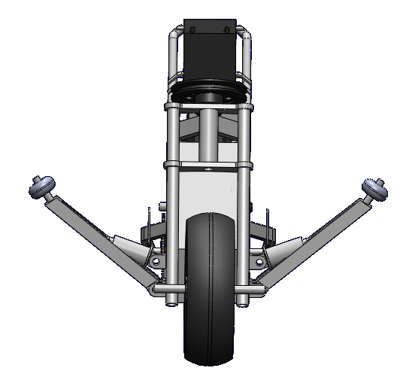
Innovative design

Slide 15
MANUFACTURING
Preliminary
Decide on type of actuation for stability wheel design.
Finalize the 3-D CAD model of frame to fit actuator.
Manufacturing
Fabricate frame and modify bike chassis to attach new mechanical design.
Pneumatic Electronic | Linear Rotary

Slide 16
testing
Phase I (Motionless Analysis)
Get high and low power systems to work independently of each other.
Integrate the entire system to communicate with one another.
Phase II (Linear Stability Corrections)
Achieve control with non-actuated stability wheels.
Allow only a small clearance between these wheels and ground.
Phase III (Curved Motion Testing)
Achieve control with actuated stability wheels.
Study dynamics of vehicle response to turning.

Slide 17
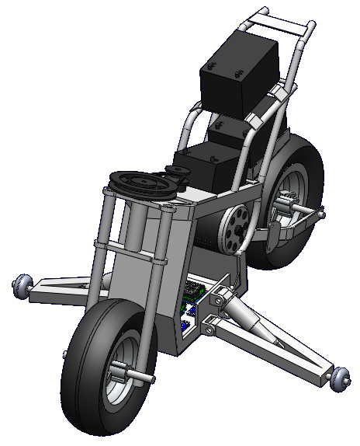
conclusion
Goals to accomplish by January 17
Complete Phase I of Testing
Fabricate a finished model for stability wheels
Begin Phase II of Testing
Special Thanks
Professor George Mansfield
Dr. Kee Moon
Eric Miller

