Slide 1
Group 16
AutoMoto
Greg Berkeley
Levi Lentz

Slide 2
Fail Early, Fail Often
Abandoning the pendulum design
Problems include
Reaction forces
Control opposite of theory
Response time
Instead focusing on other designs, primarily:
Only front wheel manipulation
Gyroscope
MORE INFO ON THIS – Whatta ya think?

Slide 3
People Talked To
FILL IN WHO YOU TALKED TO

Slide 4
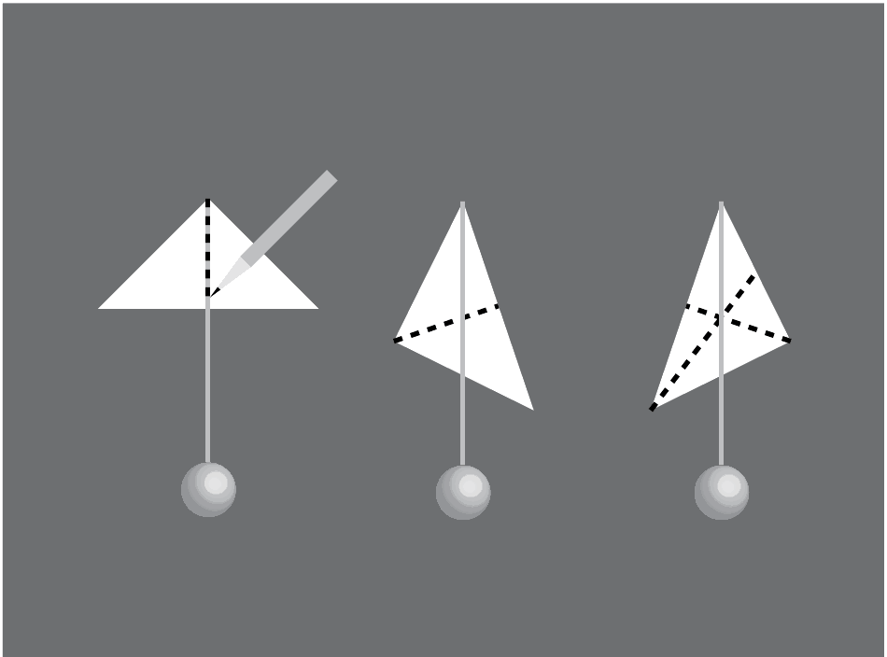
Revised Goals for Semester
Determine CG
Use plumb bob method
Need to use rig to suspend bike
Guess and Check
Dynamics of machine are not well defined
Determine if controller redesign is necessary
Faster response time

Slide 5
Next Week
Finalized design
Decision on Gyroscope design
Rework electronic to get it to turn on
Examine current state of data logging

Slide 6
Questions?

