Slide 1
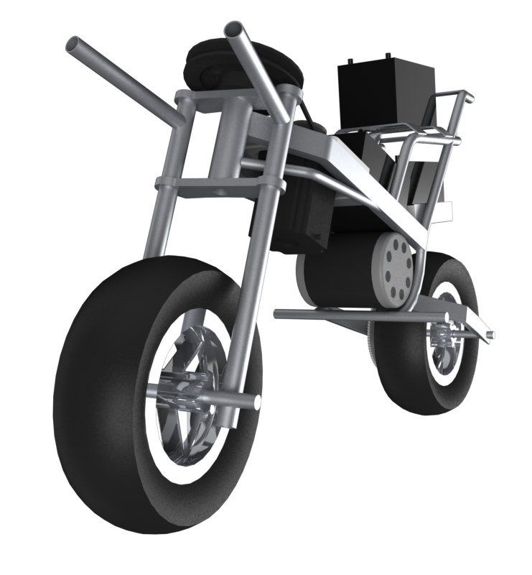
AUTOMOTO
Gregory Berkeley & Levi Lentz

Slide 2
Patents

Slide 3
Design 1
Design 1

Slide 4
Design 2
Design 2

Slide 5
Design 3
Design 3

Slide 6
Design 4
Design 4

Slide 9
Block Diagram Representation
D(s)
Controller
Plant
R(s)
Θ(s)
Sensor

