Slide 1
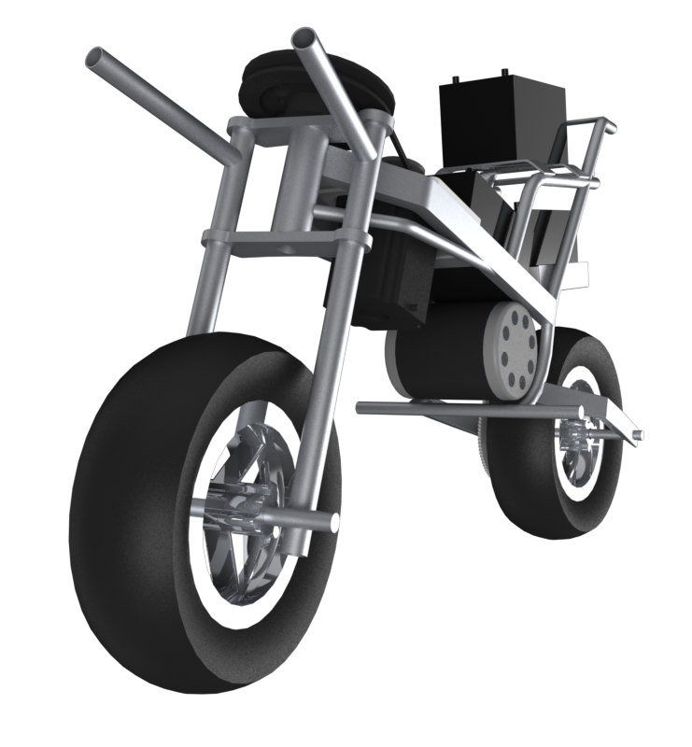
AutoMoto Group 16
Gregory Berkeley & Levi Lentz

Slide 2
Block Diagram Representation
D(s)
PID Control
Controlling Actuator
Bike Dynamics
R(s)
Θ(s)
Sensor
Certainties | Uncertainties
Modeling Bike Dynamics Response and Gain of Sensor | Gains for PID Control Controlling Actuator Design

Slide 3
Previous Design

Slide 4
Advice: Professors, Colleagues, and Professionals
Suggestions of Current Design
Professor George Mansfield MS Control Systems
Implementing sand paper and rubber wheel to simplify design.
Bode Analysis for determining PID values.
Dr. Matthew Graham Ph.D Control Theory
Instead, using a horizontal pendulum to shift CG.
Root-Locus design techniques for PID controller.

Slide 5
Advice: Professors, Colleagues, and Professionals
Suggestions of Other Designs
Dr. Key Moon Specializes in Mechatronics
Using front wheel manipulation as primary control system.
Extruding a rod from the frame with training wheels for mechanical safety.
Steve McFadden and Others ME Students
Implementing a gyroscope to achieve stability.
A robust design but would require a lot of power/torque
Gunnar Ristroph IJK Controls
Also suggested front wheel manipulation.
Suggested types of sensors and software recommendations (AVR Studio)
John Berkeley PE Otte-Berkeley Group
Also suggested front wheel manipulation.
Dr. Morteza Mehrabadi Ph.D Mechanical Engineering
Listen to Dr. Moon

Slide 6
Fail Early, Fail Often
Abandoning the pendulum design
Problems include
Reaction forces
Control opposite of theory
Response time
Instead focusing on other designs, primarily:
Only front wheel manipulation
Gyroscope

Slide 7
Revised Goals for Semester
Determine CG
Rig to suspend bike
Intersecting line method
Guess and Check
Dynamics of machine are not well defined
Determine if controller redesign is necessary
Faster response time

Slide 8
Next Week
Finalized design
Decision on Gyroscope design
Rework electronic to get it to turn on
Examine current state of data logging

Slide 9
Questions?

