Slide 1
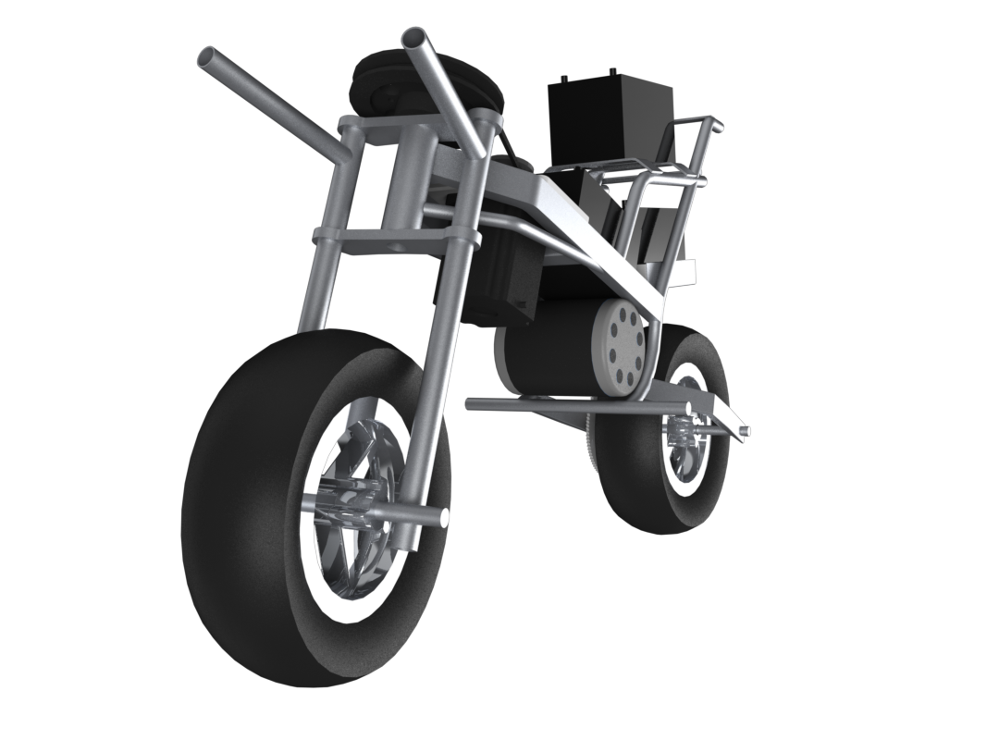
AUTOMOTO
Motorcycle Controls and Stabilization
Presented by
Gregory Berkeley & Levi Lentz
Poster Presentation

Slide 2
Outline
Motivation and Objectives
Prototype Design
Mechanical Design: Stability Wheels
Mathematical Model
Control System Diagram

Slide 3
Motivation & Objectives
Motivation
Study the behavior of motorcycle dynamics and achieve a method for stability for unmanned vehicles.
Present a sophisticated approach of feedback control theory to further develop an understanding of an autonomous motorcycle.
Objectives
Develop current design to perform at desirable stability criterion.
Add low-speed stability wheels to help prevent rolling instabilities (more later).
Reprogram microcontrollers for better response of control actuators.

Slide 4
Prototype Design
Stepper controlled front wheel provides corrective torque to maintain a stable position.
Inertial sensor measures lean angles and feedback to microcontrollers.
Low center of gravity vehicle provides less resistance to corrective torques.
Actuated stabilizing wheels to help prevent roll disturbances at low speeds.

Slide 5
Mechanical Design: Low Speed Stabilizing Wheels

Slide 6
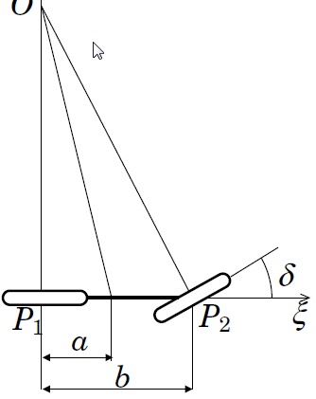
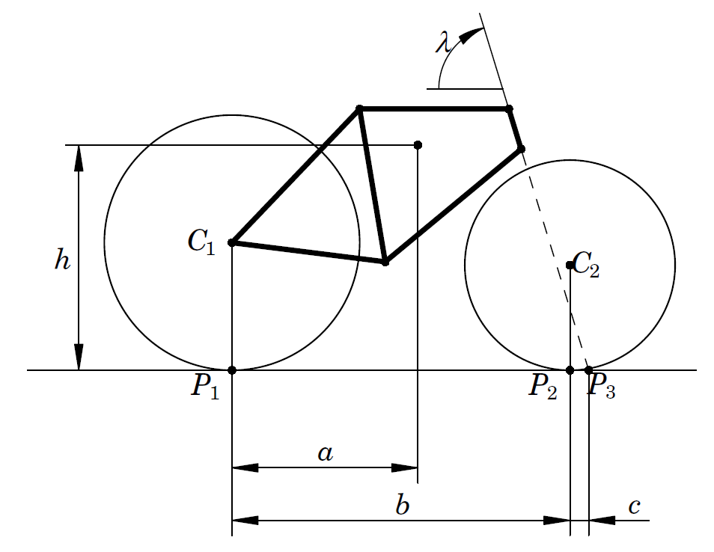
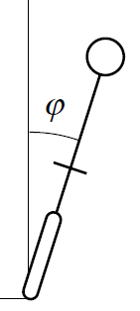
Mathematical Model

Slide 7
Equations

Slide 8
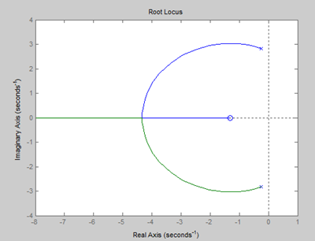
Critical Velocity
Velocity where you can ride a bike with no hands.
Root Locus at V = 5 m/s

Slide 9
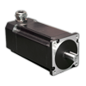
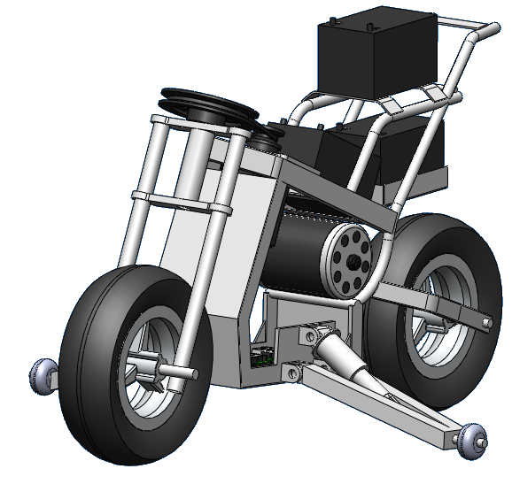
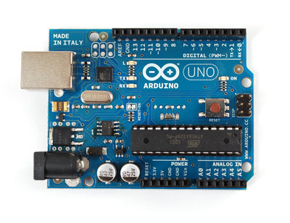
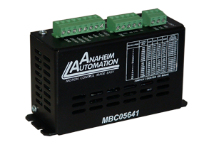
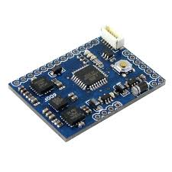
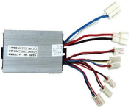
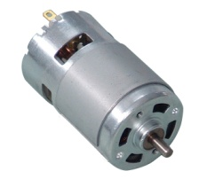
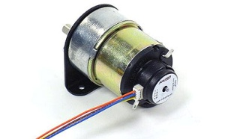
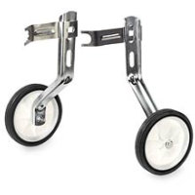
Control System Diagram
Feedback Encoder
AA 34Y
Steering Microcontroller
Arduino Uno
Step Motor Driver
AA MBC05641
1700 oz-in Step Motor
AA 34Y
Motorcycle Dynamics
Inclination Sensor
ArduIMU V2
Drive Microcontroller
Arduino Uno
Speed Controller
SPD-36500B
700W DC Motor
JX My1070
Feedback Tachometer
JX My1070
Ascend/Descend
Training Wheels
Training Wheels
Manufactured
Feedback Signal
Actuating Signal

Slide 10
Thank You

