Slide 1
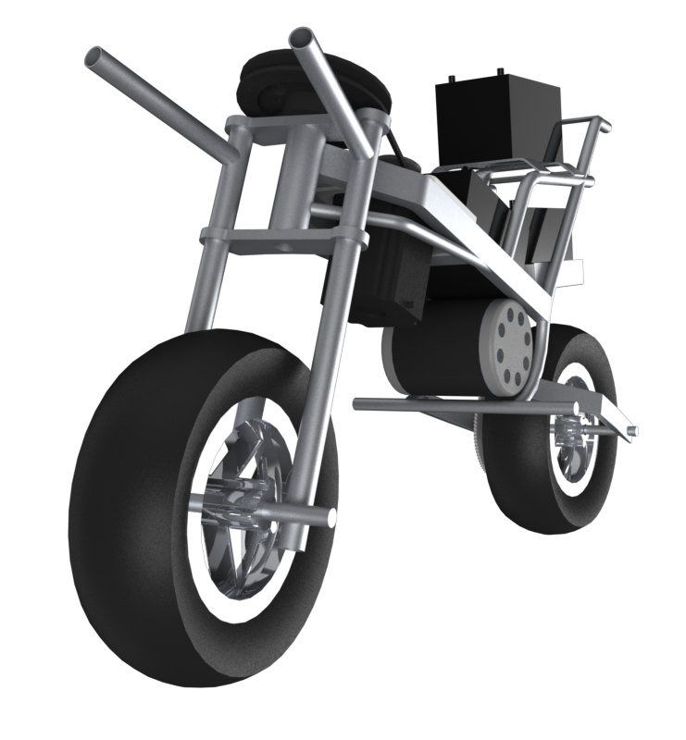
AUTOMOTO
Group 16
Gregory Berkeley
Levi Lentz

Slide 2
Acomplishments
1. Found Center of Gravity
7 inches from the vertical
2. Developed Parts List and Spec Sheets
Motors, Drivers, Controllers, Batteries
3. One microprocessor was missing a DC adapter from a 9V
Soldered adapter to 9V leads giving the unit power
4. Set up simple Arduino commands

Slide 3
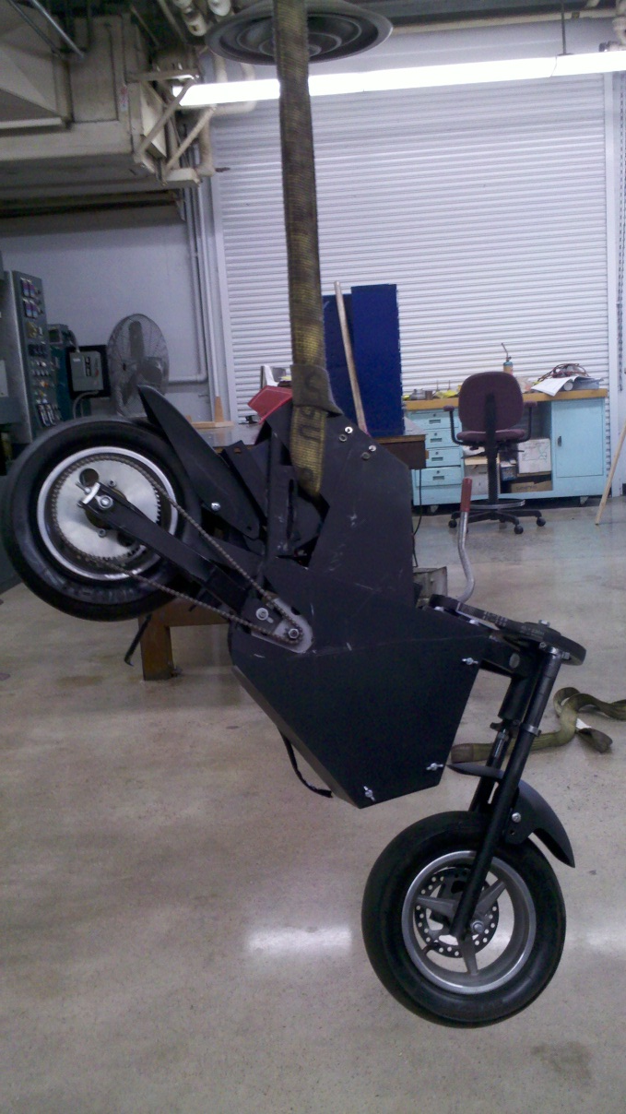
Center Of Gravity

Slide 4
Flaw with Previous Design
Only were using a proportional control with a gain of 1 for control steering
No Integral or Derivative Control
Too slow of a time response to achieve stability
Evidence found in videos from the previous team
Our Remedy
Reconfigure the control system to incorporate PID controls

Slide 5
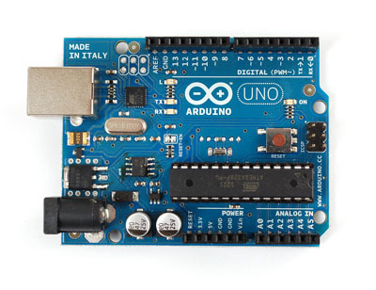
Microprocessing
Currently using two Arduinos
One to drive DC Motor
Another to control stepper motor steering
Programming is very similar to C
Task 1: Get sensor and Arduino to talk to each other and read data (ArduFlight)
Task 2: Incorporate Stepper Motor to test time response

Slide 6
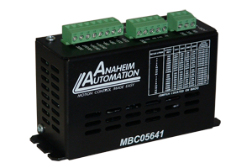
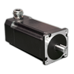
Pulse Width Modulation

Slide 7
Gull-Wing Training Wheels
Retractable “Training Wheels”
Solve problem of starting the vehicle
Will retract in a Gull-Wing manner
Add to the rotational inertia of the bike
Linear actuation via 4 bar link
Or with simple rotation

Slide 8
Future Work
Get electronics to work
Independent high- and low-power systems
Eventual integration of both systems
Contact previous team for full wiring schematic
Review previous code
Design “Training Wheels”
Cad design
Rotation or 4-bar link
Integrate control into speed-sensing Arduino

